Slide 1
Series of AeoLiS animations

Slide 2
Explain observations
Over-estimation of sediment transport
Varying fetch effects
Tide dependency

Slide 4
1. Constant sediment supply varying wind
New animation is available, but I got lazy and want to move on.

Slide 5
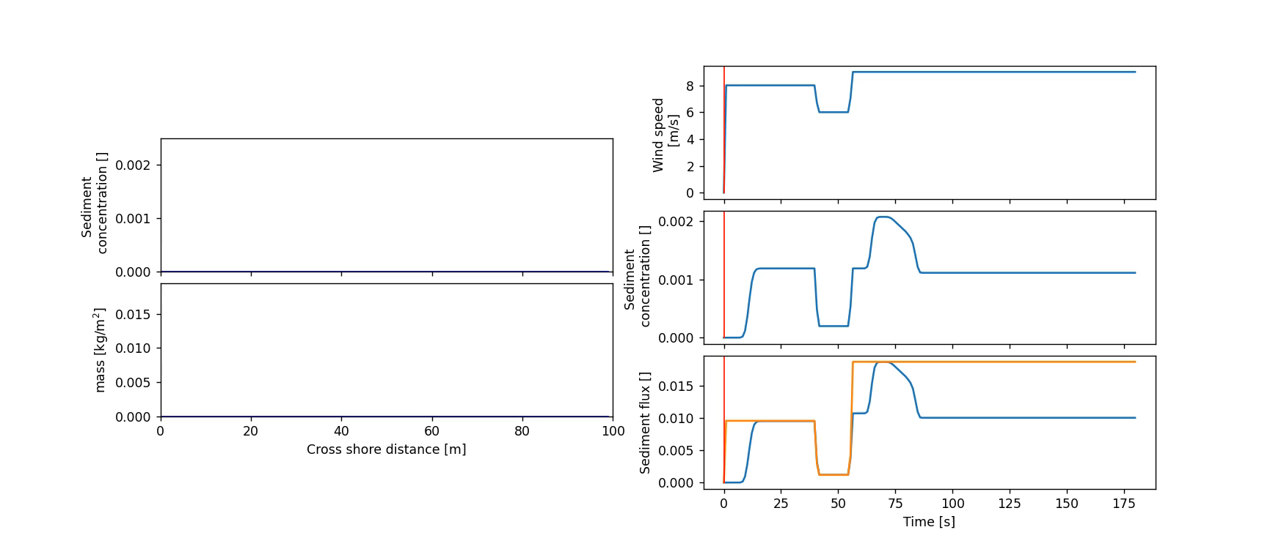

Slide 8
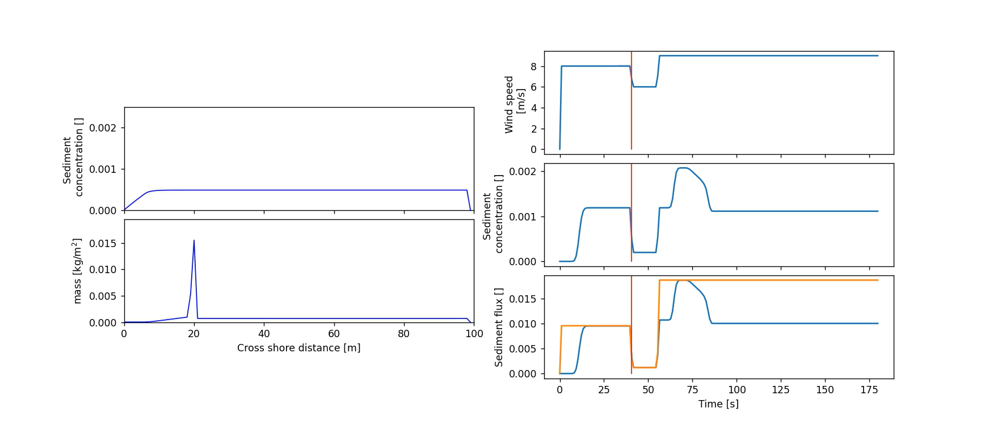

Slide 9
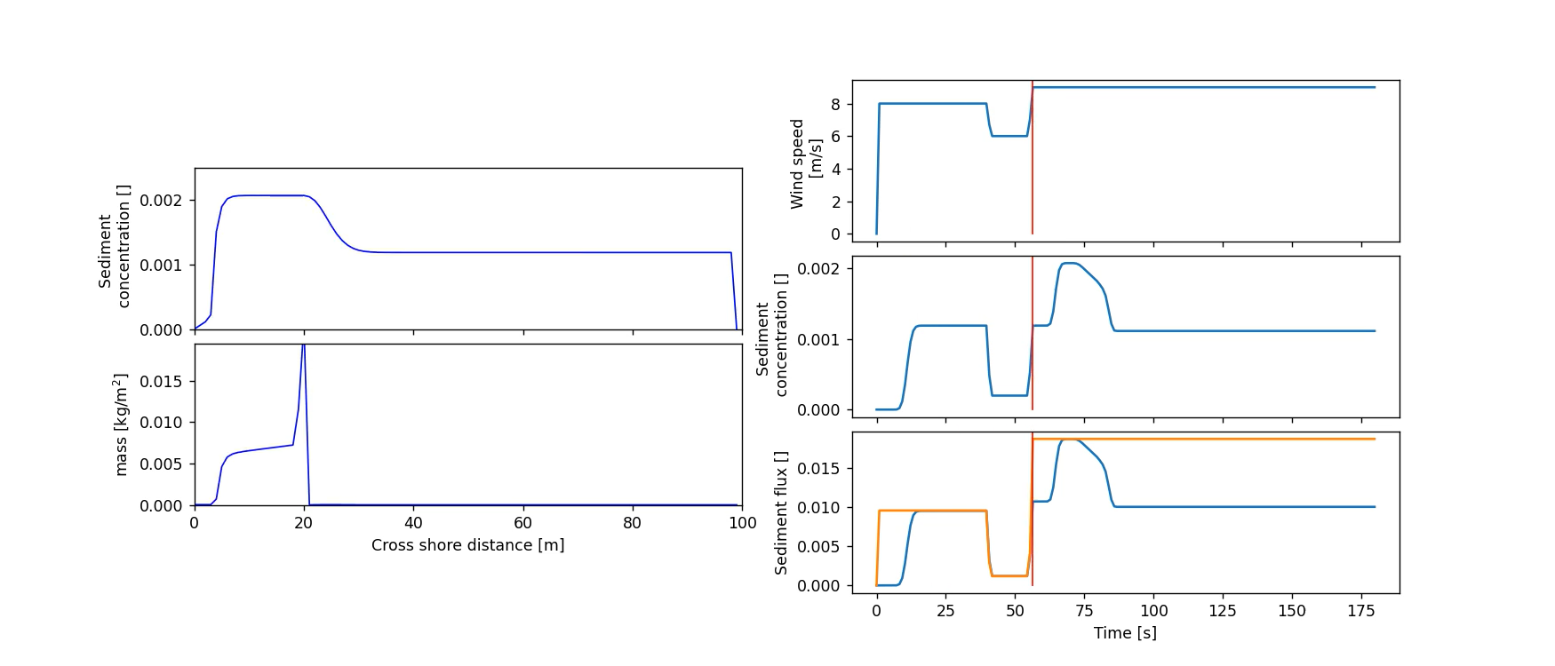

Slide 10
Varying wind direction

Slide 14
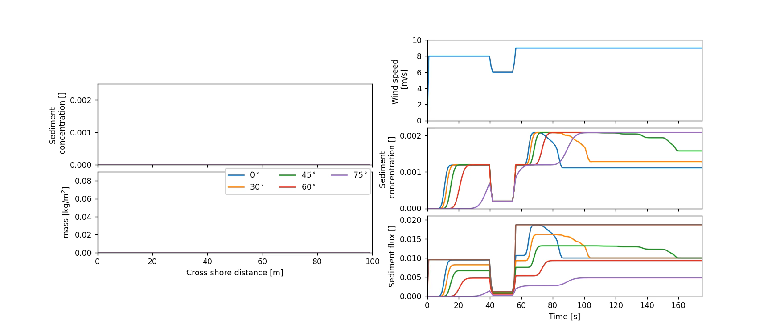

Slide 15
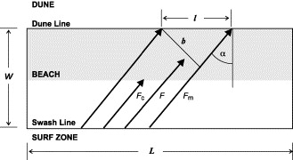
Comparable to the work of Bauer and Davidson Arnott.

Slide 16
Tide dependency

Slide 19
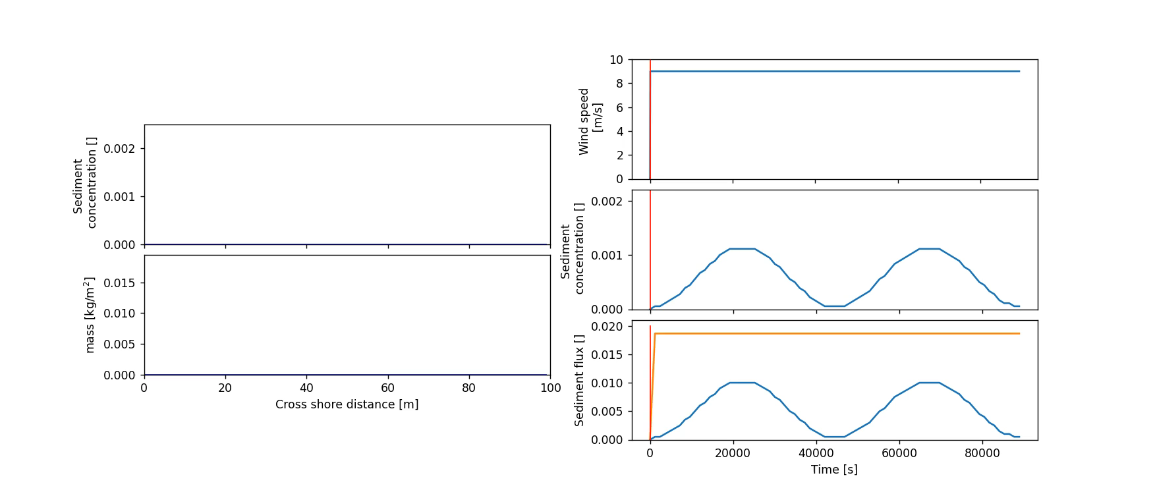

Slide 20
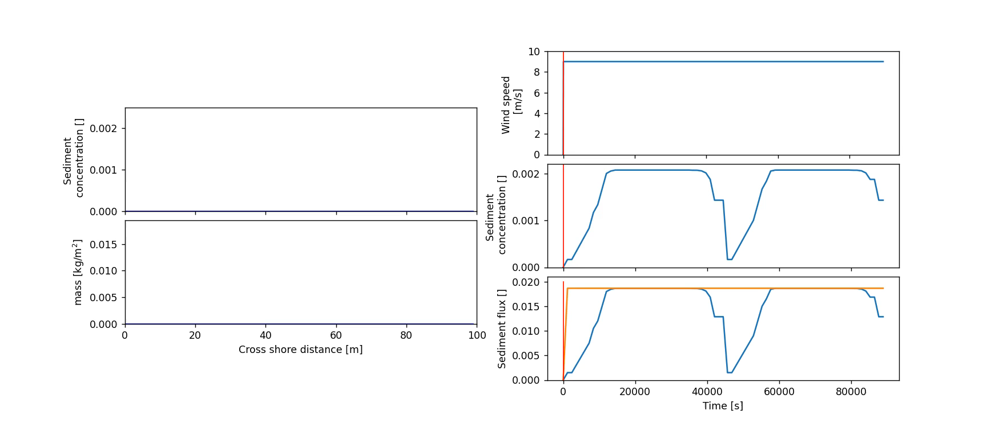

Slide 21
Changing wind direction
Distance over the beach incl. supply area changes.

Slide 24
Wind [m/s]
y-direction
Sediment Supply
No Sediment Supply
Downwind Boundary
x-direction

